Slide 1
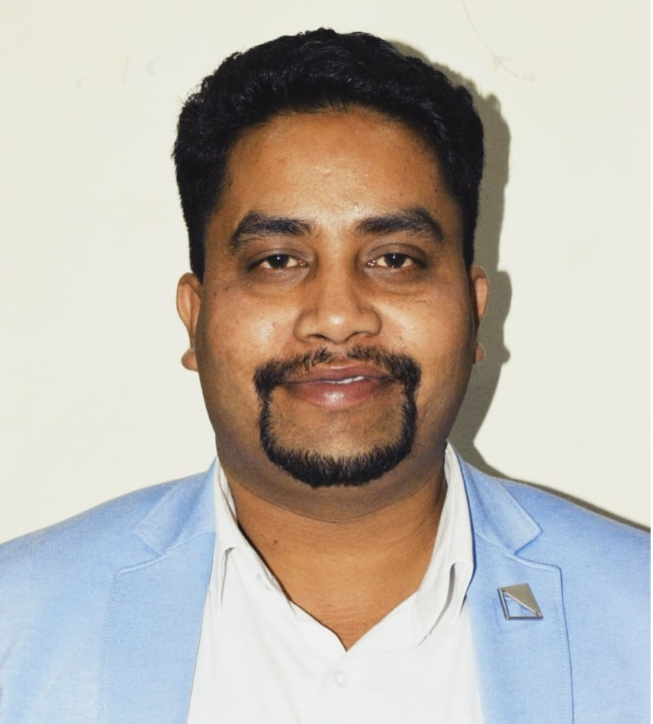
IBM Maximo Fundamental Training
Five Days Training Program
DR.HITESH KUMAR SHARMA
Senior Associate Professor
Technical Instructor & Consultant

Slide 2
ABOUT ME
Industry and Training Experience: 15 Years
Worked as IBM Instructor
Worked as Microsoft Instructor
Working as NobleProg Instructor
Core Technical Domains: IBM MAS, SAP, Six Sigma, EAM, Android/iOS App Development, UiPath RPA, DevOps, Data Analytics
Academic Qualifications: Ph.D. (CSE), M.Tech (CSE)
Certifications:
Six Sigma
UiPath RPA Certified Associate
Docker Certified Associate
Neo4J Certified Associate
Maven Certified Professional
4 Books Published
30 Patents Published
02 Copyright Published
DR.HITESH KUMAR SHARMA
Technical Instructor & Consultant

Slide 3
4 Hours Daily of Instructor-Led Training
Slides Based Content
Hands-on Live Demo
Lab Exercises
Video Based Demo
Whiteboard/ Pen Tab based Interaction
Daily Recap
Lesson-End Assignment
Course-End Projects
30 Mins Break on an Interval of 2 Hours
DELIVERY MODE

Slide 4
Asset
An asset is a resource with economic value that an individual, corporation, or country owns or controls with the expectation that it will provide a future benefit.
Assets are reported on a company's balance sheet.
They are bought or created to increase a firm's value or benefit the firm's operations.
An asset is something that may generate cash flow, reduce expenses or improve sales, regardless of whether it's manufacturing equipment or a patent.
Assets can be classified as current, fixed, financial, or intangible.

Slide 5
Types of Asset
Current assets | Fixed assets | Tangible assets | Intangible assets | Operating assets | Non-operating assets
Cash Mutual funds Marketable securities | Buildings and land Machinery Vehicles IT equipment | Machinery Buildings Equipment Cash Supplies Land Inventory | Intellectual property Patents Copyrights Goodwill Brand equity Intellectual property | Cash Buildings Copyrights Goodwill Machinery Buildings Patents | Vacant land Interest income from fixed deposits Marketable securities Short-term investments

Slide 6
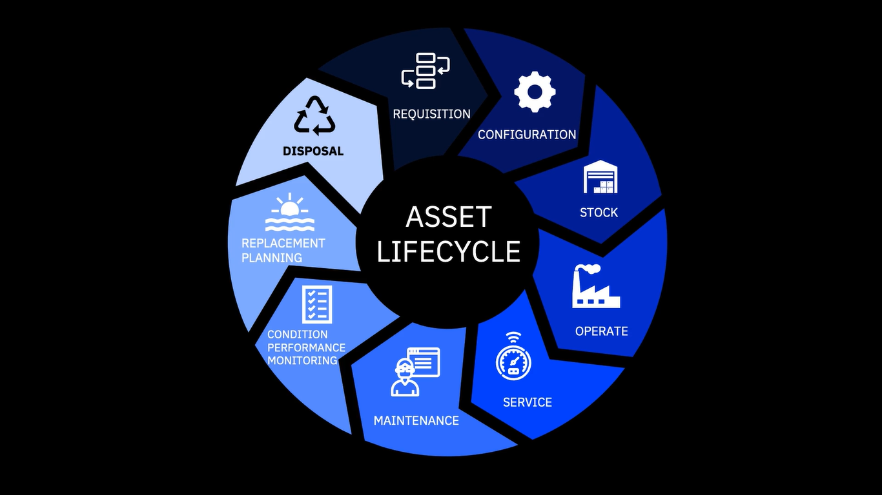

Slide 7
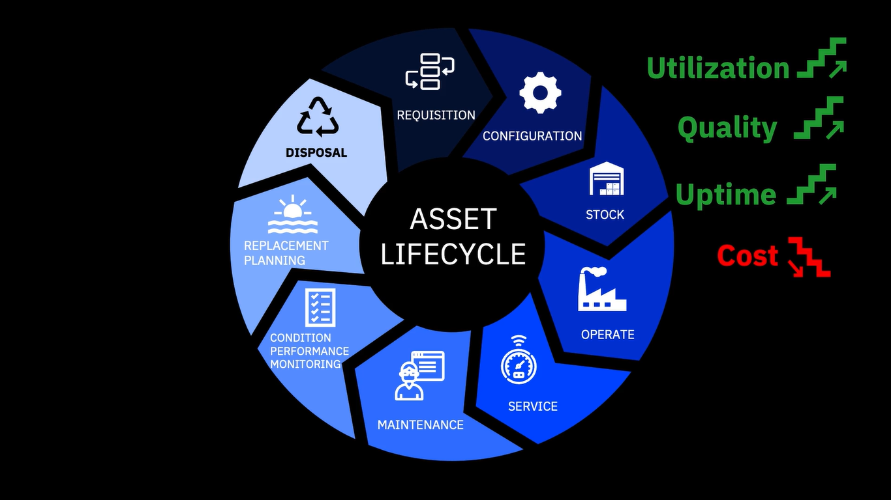

Slide 8
Asset Management Software
Asset management software is a dedicated application which is used to record and track an asset throughout its life cycle, from procurement to disposal. It provides an organization with information like where certain assets are located, who is using them, how they are being utilized and details about the asset. The asset management software is used for management of both software and hardware assets.

Slide 9
Benefits of Asset Management Software
Maximize utilization and value of assets
Enable informed decision making through cost transparency
Proactive software license compliance
Manage services as well as assets
Track vendor and supplier performance through transparent metrics
Optimized allocation of assets for greater return on investment

Slide 10
Enterprise Asset Management (EAM)
Enterprise Asset Management (EAM) is the management of the assets of an enterprise across departments, facilities, business units and geographical locations. EAM integrates techniques for holistic control and optimization throughout asset life cycles, including design, commissioning, operations and replacement.

Slide 11
Benefits of Asset Management Software
Maximized ROA
Reduced costs and risks
Improved asset decision making
Compliance with required regulations
Increased asset service responses and enhanced efficiency
Lowered TCO

Slide 12
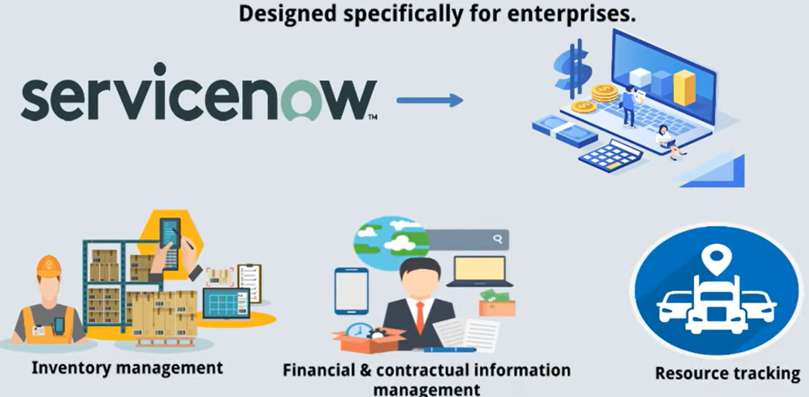
ServiceNow

Slide 13
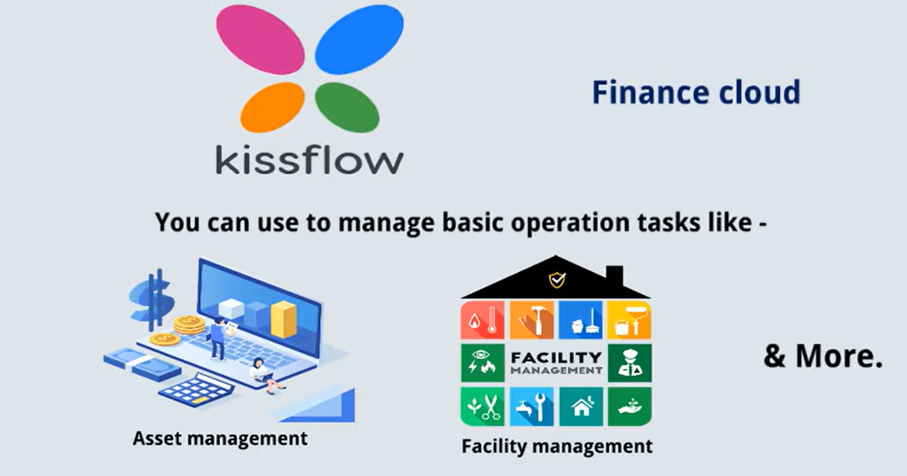
Kissflow

Slide 14
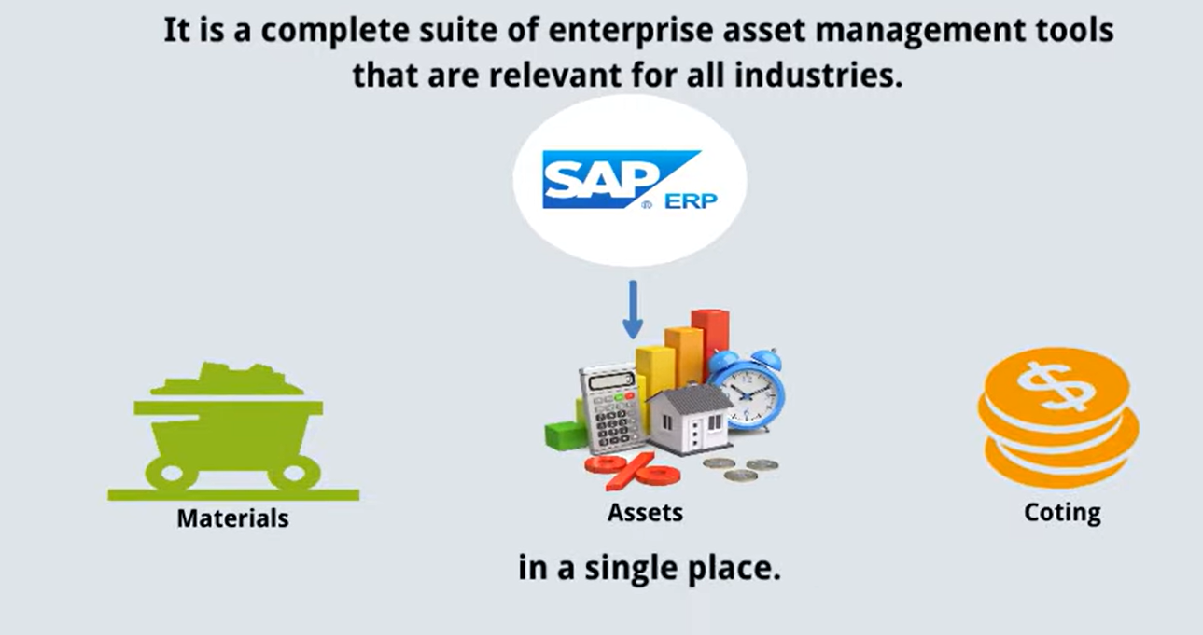
SAP ERP Suite

Slide 15
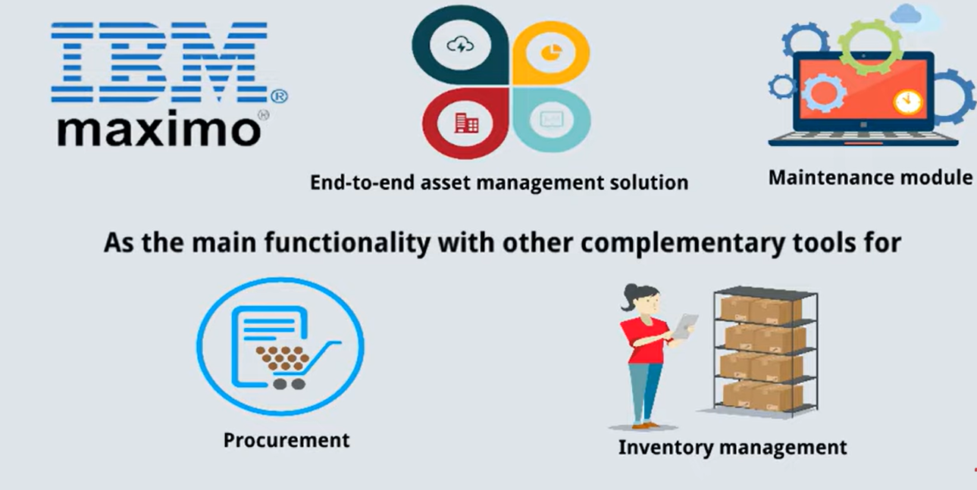
IBM Maximo Application Suite

Slide 16
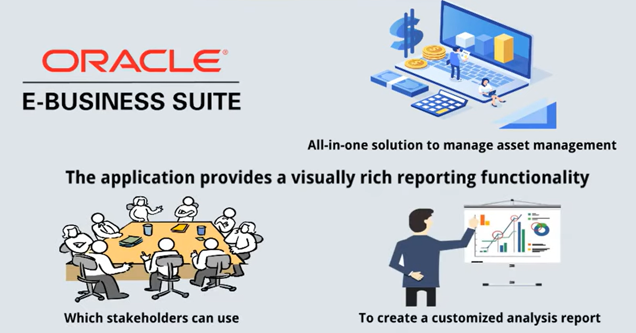
Oracle E-Business Suite

Slide 17
IBM Maximo Application Suite (MAS)

Slide 18
